Slide 1
Digital Fundamentals
CHAPTER 4
Boolean Algebra and Logic Simplification

Slide 2
Chapter Outline
4–1 Boolean Operations and Expressions
4–2 Laws and Rules of Boolean Algebra
4–3 DeMorgan’s Theorems
4–4 Boolean Analysis of Logic Circuits
4–5 Logic Simplification Using Boolean Algebra
4–6 Standard Forms of Boolean Expressions
4–7 Boolean Expressions and Truth Tables
4–8 The Karnaugh Map
4–9 Karnaugh Map SOP Minimization
4–10 Karnaugh Map POS Minimization
4–11 The Quine-McCluskey Method
4–12 Boolean Expressions with VHDL Applied Logic

Slide 3


Boolean Operations and Expressions
Addition
  0 + 0 = 0
  0 + 1 = 1
  1 + 0 = 1
  1 + 1 = 1
Multiplication
  0 * 0 = 0
  0 * 1 = 0
  1 * 0 = 0
  1 * 1 = 1

Slide 4
Laws Boolean Algebra
Commutative Laws for:
  Addition
  Multiplication
Associative Laws for:
  Addition
  Multiplication
Distributive Law
A + B = B + A
A * B = B * A
A + (B + C) = (A + B) + C
A * (B * C) = (A * B) * C
A(B + C) = AB + AC

Slide 5
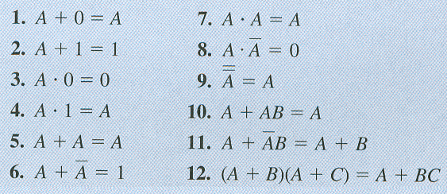
Rules of Boolean Algebra

Slide 6
Derivation of Simlification
A +AB = A + B

Slide 7
Duality Principle
A Boolean equation remains valid if we take the dual of the expression on both sides of the equation sign
Dual of expressions
  Interchange 1’s and O’s
  Interchange And (*) and OR (+)

Slide 8
4–3 DeMorgan’s Theorem
State DeMorgan’s theorems
Relate DeMorgan’s theorems to the equivalency of the
  NAND and negative-OR gates
  NOR and negative-AND gates
Apply DeMorgan’s theorems to the simplification of Boolean expressions
Notes:
In Chapter 3 we have discussed (Slide # 31)
NAND and negative-OR gates
NOR and negative-AND gates
DeMorgan’s theorems provide mathematical verification of the equivalency of the NAND and negative-OR gates and the equivalency of the NOR and negative-AND gates,
After completing this section, you should be able to

Slide 9
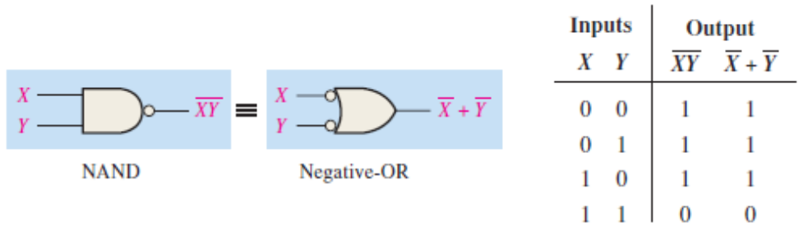

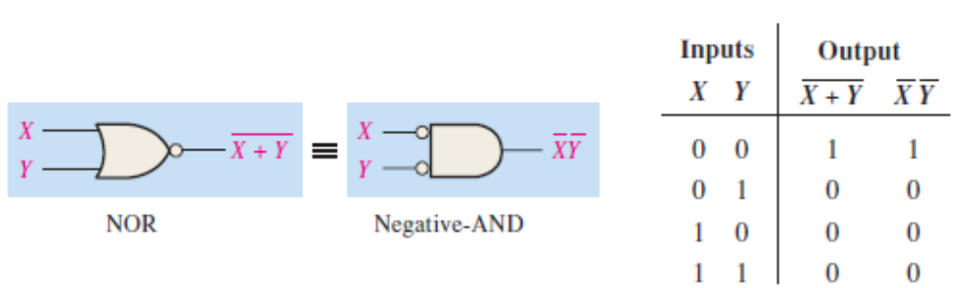
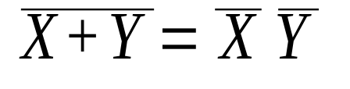
DeMorgan’s Theorems
Theorem 1
Theorem 2
Remember:
  “Break the bar,
  change the sign”
Notes:
DeMorgan’s first theorem is stated as follows:
The complement of a product of variables is equal to the sum of the complements of the variables.
Stated another way,
The complement of two or more ANDed variables is equivalent to the OR of the complements of the individual variables.
DeMorgan’s second theorem is stated as follows:
The complement of a sum of variables is equal to the product of the complements of the variables.
Stated another way,
The complement of two or more ORed variables is equivalent to the AND of the complements of the individual variables.

Slide 10
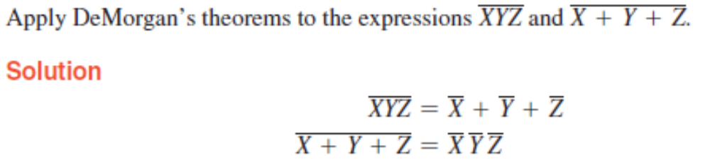
DeMorgan’s Theorems

Slide 11
DeMorgan’s Theorems

Slide 12
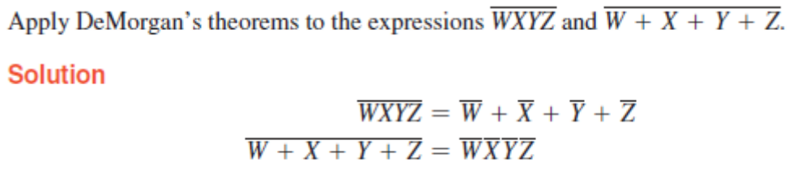
DeMorgan’s Theorems

Slide 13
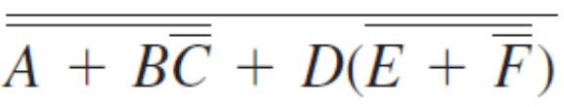
Applying DeMorgan’s Theorems

Slide 14
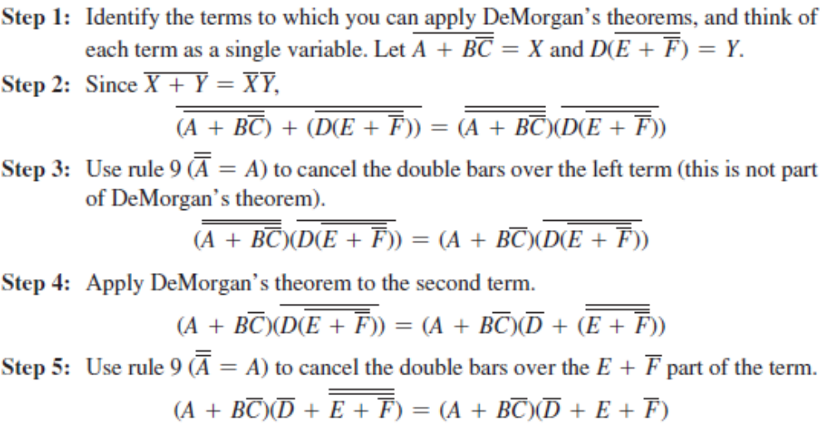
Applying DeMorgan’s Theorems
A
+
B
=
C
( D(E+F))
( )

Slide 15
Applying DeMorgan’s Theorems
A
+
B
C
( D(E+F))
=
( )

Slide 16
Applying DeMorgan’s Theorems

Slide 17
Applying DeMorgan’s Theorems

Slide 18
Applying DeMorgan’s Theorems

Slide 19
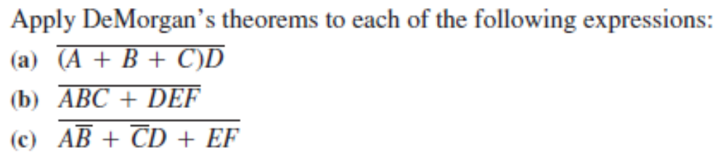
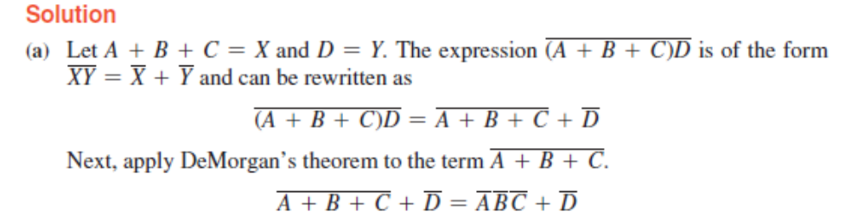
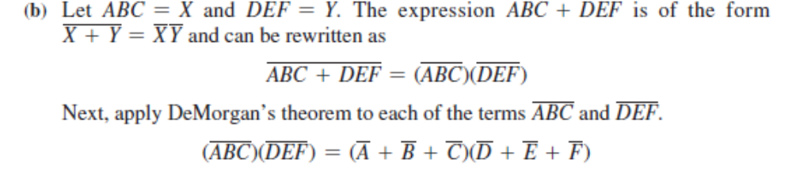
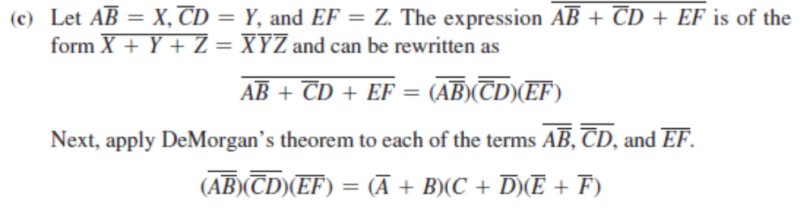

Slide 20
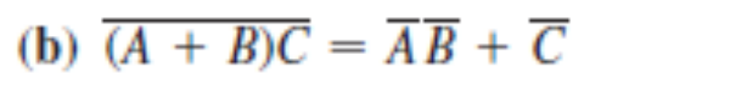
Checkup

Slide 21
4–4 Boolean Analysis of Logic Circuits
Determine the Boolean expression for a combination of gates
Evaluate the logic operation of a circuit from the Boolean expression
Construct a truth table
Notes:
Boolean algebra provides a concise way to express the operation of a logic circuit formed by a combination of logic gates so that the output can be determined for various combinations of input values. After completing this section, you should be able to

Slide 22
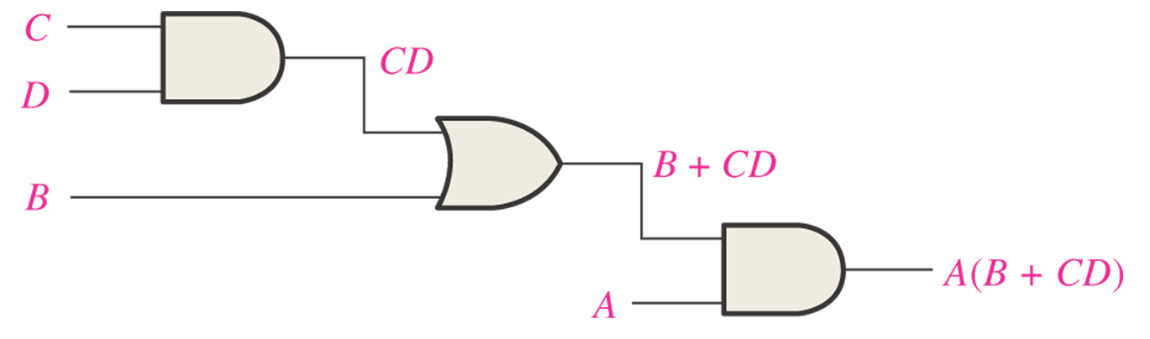
Figure 4–16
A logic circuit showing the development of the Boolean expression for the output.
CD
B + CD
A(B + CD)

Slide 23
Evaluating the Expression
A(B + CD), first find the values of the variables that make the
expression equal to 1, using the rules for Boolean addition and multiplication. In this case, the expression equals 1 only if A = 1 and B + CD = 1 because
A(B + CD) = 1.1 = 1
Now determine when the B + CD term equals 1.
The term B + CD = 1 if either B = 1 or CD = 1 or if both B and CD equal 1 because
B + CD = 1 + 0 = 1
B + CD = 0 + 1 = 1
B + CD = 1 + 1 = 1
The term CD = 1 only if C = 1 and D = 1.
summarize, the expression A(B + CD) = 1 when A = 1 and B = 1 regardless of
the values of C and D or when A = 1 and C = 1 and D = 1 regardless of the value of B.
The expression A(B + CD) = 0 for all other value combinations of the variables

Slide 24
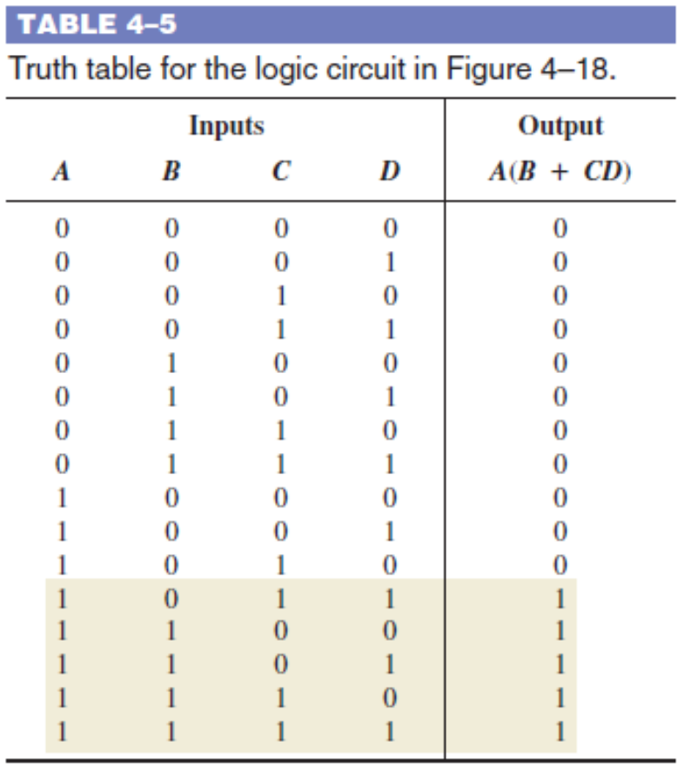
Putting the Results in Truth Table Format
The first step is to list the sixteen input variable combinations of 1s and 0s in a binary sequence as shown in Table 4–5.
Next, place a 1 in the output column for each combination of input variables that was determined in the evaluation.
Finally, place a 0 in the output column for
all other combinations of input variables.

Slide 25
Checkup
1. Replace the AND gates with OR gates and the OR gate with an AND gate in Figure 4–18. Determine the Boolean expression for the output.
2. Construct a truth table for the circuit in Question 1.
Solution:
(C + D)B + A
The expression is a 1 when A is 1 or when B and C are 1s or when B
and D are 1s. The expression is 0 for all other variable combinations.

Slide 26
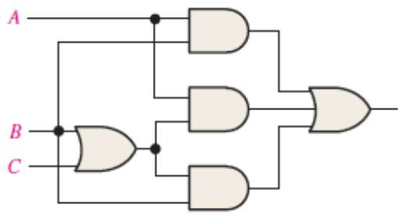

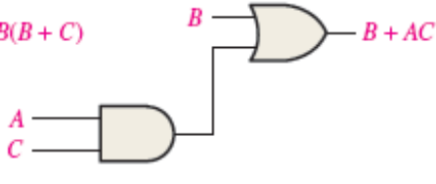
4–5 Logic Simplification Using Boolean Algebra
A simplified Boolean expression uses the fewest gates possible to implement a given
expression.
Using Boolean algebra techniques, simplify this expression:
AB + A(B + C) + B(B + C)
Solution
The following is not necessarily the only approach.
Step 1: Apply the distributive law to the second and third terms in the expression, as follows:
AB + AB + AC + BB + BC
Step 2: Apply rule 7 (BB = B) to the fourth term.
AB + AB + AC + B + BC
Step 3: Apply rule 5 (AB + AB = AB) to the first two terms.
AB + AC + B + BC
Step 4: Apply rule 10 (B + BC = B) to the last two terms.
AB + AC + B
Step 5: Apply rule 10 (AB + B = B) to the first and third terms.
B + AC

Slide 27
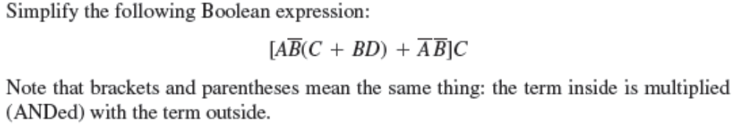
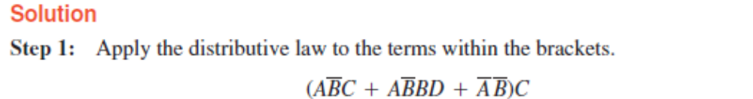

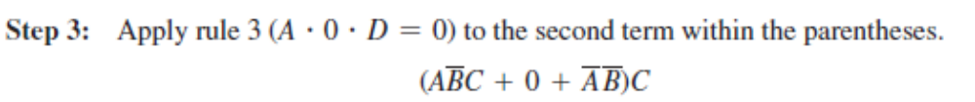

4–5 Logic Simplification Using Boolean Algebra

Slide 28
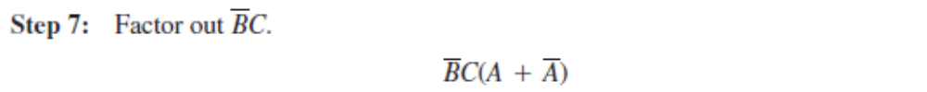

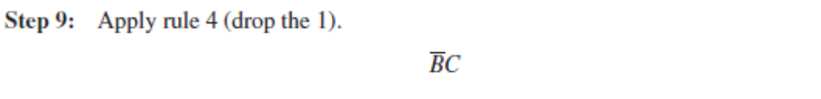
4–5 Logic Simplification Using Boolean Algebra

